Slide 1





Slide 2
Data-Driven Diagnosis: A Machine Learning Approach to Diabetes Detection
Allyn Christian I. Quiamjot

Slide 3
Diabetes Statistics
~537 million people worldwide suffers from diabetes (10.5% of population) according to International Diabetes Federation
11.3% of total population will develop diabetes by 2030
Medical tests are expensive and subject to availability
Is there an alternative way to predict/diagnose diabetes?

Slide 4
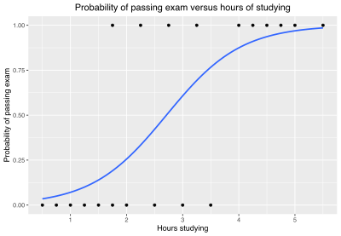
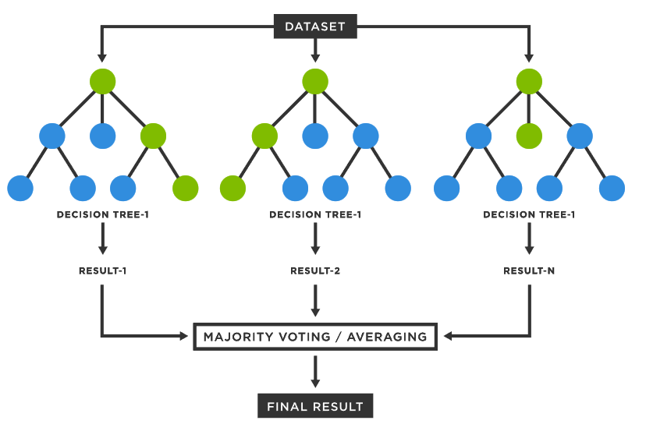
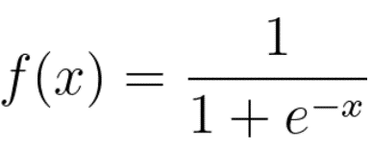
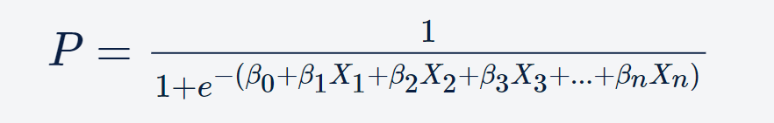
Logistic regression
Random forest classifier

Slide 5
Logistic regression
Random forest classifier
Returns probability (0 to 1) of belonging to a class based on a linear combination of features
Computationally cheap
Prioritizes interpretability
Predictions are based from multiple decision trees
Computationally expensive
Prioritizes accuracy

Slide 6
methodology
Logistic Regression
Evaluate accuracy, specificity, and sensitivity
Dataset
Split into training and testing set
Test on custom parameters
Random Forest Classifier

Slide 7
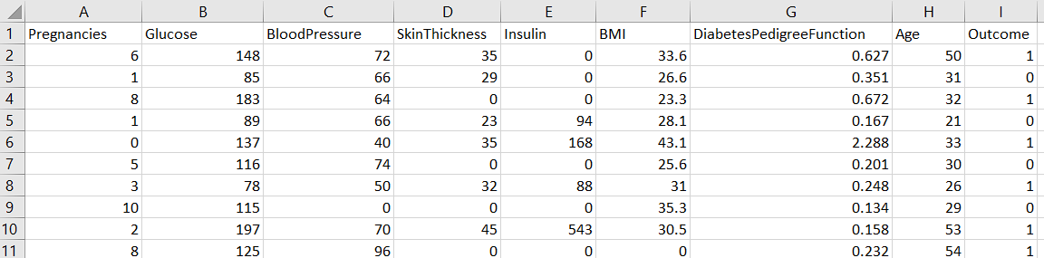
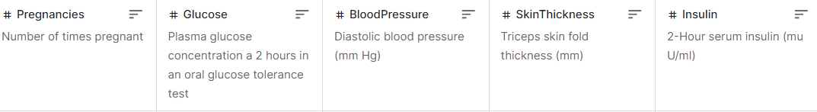
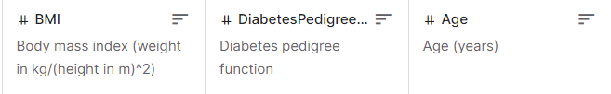
768 samples, females, >21 years old
Pima Indians Diabetes Database. Retrieved from https://www.kaggle.com/datasets/uciml/pima-indians-diabetes-database

Slide 8
RESULTS

Slide 9
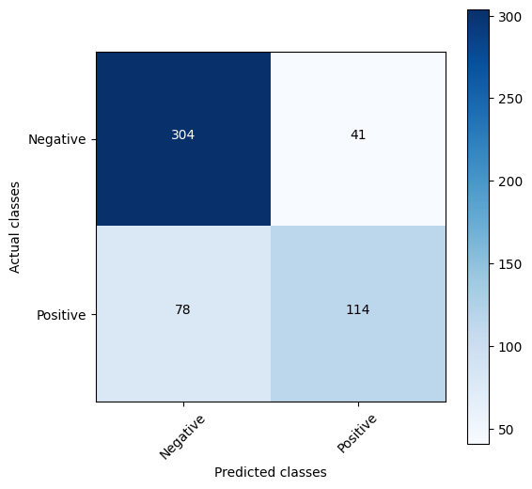
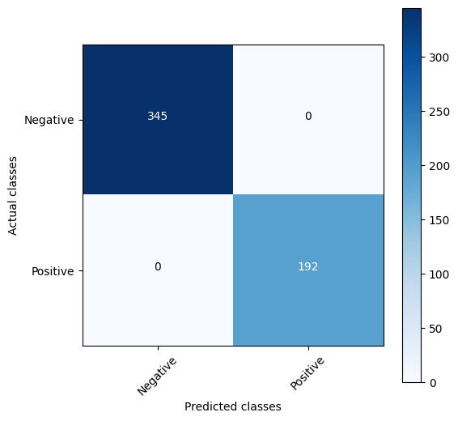
Logistic regression
Random forest classifier
Accuracy: 77.84%
Sensitivity: 59.38%
Specificity: 88.12%
TRAINING
Accuracy: 100%
Sensitivity: 100%
Specificity: 100%

Slide 10
Logistic regression
Random forest classifier
Accuracy: 75.76%
Sensitivity: 59.21%
Specificity: 83.87%
TESTING
Accuracy: 76.19%
Sensitivity: 61.84%
Specificity: 83.23%

Slide 12
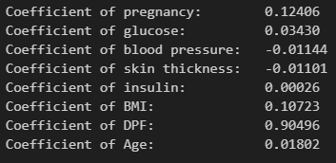
Positive coefficient denotes positive relationship between feature and predicted probability
Negative coefficient denotes negative relationship

Slide 13
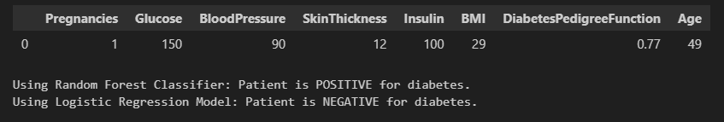

Slide 14
conclusion
Potential of machine learning methods in predicting diabetes was demonstrated
Logistic regression: lower accuracy & sensitivity, higher specificity
Random forest classifier: higher accuracy & sensitivity, lower specificity
These models can serve as valuable tools in the early detection of diabetes

Slide 15
Moral of the story: eat healthy, live healthy

Slide 16
references
Chou CY, Hsu DY, Chou CH. Predicting the Onset of Diabetes with Machine Learning Methods. J Pers Med. 2023 Feb 24;13(3):406. doi: 10.3390/jpm13030406. PMID: 36983587; PMCID: PMC10057336
Pima Indians Diabetes Database. Retrieved from https://www.kaggle.com/datasets/uciml/pima-indians-diabetes-database
What is Logistic Regression?. Retrieved from https://www.spiceworks.com/tech/artificial-intelligence/articles/what-is-logistic-regression/
IMAGES ARE OPEN SOURCE

